Slide 1

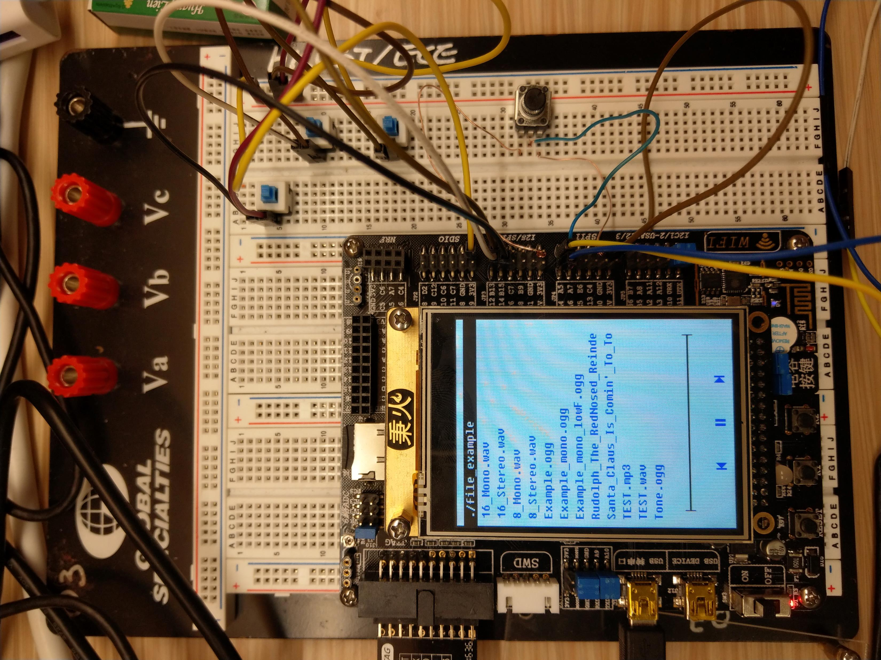
Music Player
ELEC3300 Project

Slide 2
Function 1
Display file names and buttons on LCD screen

Slide 3

Function 2
Move Up
Buttons to navigate and select
Move Down

Slide 4

Function 3
Play .wav (8/16bit, Mono/Stereo) and .ogg file(in certain conditions)

Slide 5
Function 4
Adjust volume by turning the rheostat

Slide 6
Function 5
Last song
Next song
Interact using the touch screen
Play / Pause

Slide 7

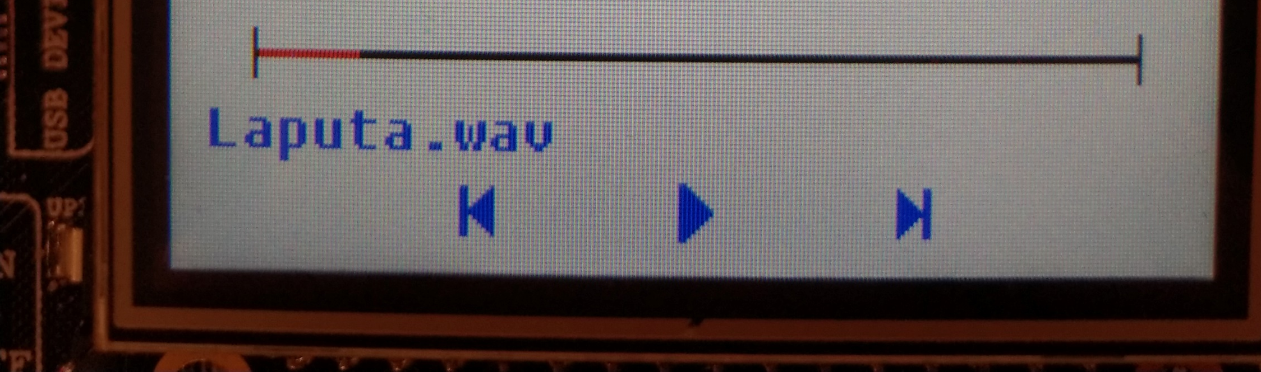
Function 6
Progress bar
Show progress in red color

